Slide 1
Let’s Play Trivia…
And Win Prizes of Course!
Notes:
Kristen

Slide 2
The Rules
Each table is a team
Work with your table-mates to determine the correct answer
Write your answer on the sheet provided (no changing answers once you have written them down)
Think hard – the winning table will win PRIZES!! (yeah!)
Notes:
Kristen

Slide 3
Question #1
Title IX is a landmark federal civil right that prohibits discrimination based on what in education?
  Sex discrimination
  Race discrimination
  Age discrimination
Notes:
Kristen
Sex-Gender
10 points

Slide 4
Question #2
Title IX applies only to students who participate in athletics
  True
  False
Notes:
Kristen
False
10 po

Slide 5
Question #3
What is the reported percentage of college women that will be victims of sexual assault while at college?
  20%
  0%
  5%
Notes:
Kristen
20 %
10 points

Slide 6
Question #4
Alcohol is rarely involved in cases of sexual assault on college campuses
  True
  False
Notes:
Kristen
FALSE
10 points

Slide 7
Question #5
Incapacitation is defined as a state where someone cannot make rational, reasonable decisions because they lack the capacity to give knowing consent (eg, to understand the who, what, when, where, why or how of their sexual interaction).
At what blood alcohol content is a person considered incapacitated?
  .08
  .10
  There is no defined BAC in which a person is considered incapacitated. Rather, it depends on each individual person.
Notes:
Kristen
There is no defined
10 points

Slide 8
Question #6
A person can become incapacitated for reasons other than just over-indulging in alcohol
  True
  False
Notes:
Kristen
True
10 points

Slide 9
Question #7
Some people don’t realize it, but Title IX also addresses stalking and domestic/intimate partner violence.
  True
  False
Notes:
Kristen
True
20 points

Slide 10
Question #8
1 in 3 women and 1 in 4 men in the US will be in a violent relationship in their lifetime.
  True
  False
Notes:
Kristen
True
20 points

Slide 11
Question #9
Nearly 50% of women and 40% of men who experience relationship violence will experience it for the first time between the ages of 18-24.
  True
  False
Notes:
Kristen
True
20 points

Slide 12
Question #10
Federal law requires colleges to take immediate action to ensure a victim of sexual harassment can continue their education free of ongoing discrimination, harassment, or violence.
  True
  False
Notes:
Kristen
True
10 points

Slide 13
Question #11
A person who is a victim of sexual harassment can report CONFIDENTIALLY to:
  The Rose-Hulman Counseling Office staff
  A resident assistant
  A faculty member
Notes:
Kristen
RHIT Counseling
20

Slide 14
Tally ‘em Up!
Let’s review the answers (and learn a few things along the way)
Add up your score
Prize time! (we never said they would be GOOD prizes)
Notes:
Kristen

Slide 15
Let’s Talk Title IX
No person in the United States shall, on the basis of sex, be excluded from participation in, be denied the benefits of, or be subjected to discrimination under any educational program or activity receiving financial assistance
Notes:
Kyle

Slide 16
Let’s Talk Title IX
Why is this important on a college campus?
Creates a hostile environment
Education provides opportunity
  Civil rights and a social justice issue
Criminal Court versus Higher Ed
Notes:
Kyle

Slide 17
Let’s Talk Title IX
Schools must be proactive in ensuring their campus is free of discrimination based on sex
A school put “on notice” of possible sexual harassment of a student must take immediate and appropriate steps to do FOUR very specific things
Notes:
Kyle

Slide 18
Let’s Talk Title IX
1. Investigate what occurred
2. Take prompt and effective action to end the harassment
3. Remedy the effects
4. Prevent it from occurring again
Notes:
Kyle

Slide 19
Let’s Talk Title IX
As well, schools/employees/students may not retaliate against someone filing a complaint
Retaliation is a serious offence. Rose-Hulman will investigate all reports of retaliation and determine appropriate sanctions.
Notes:
Kyle

Slide 20
Rose-Hulman Takes Action
  Rose-Hulman Policy for Civil Rights Equity
  This policy is located in the student handbook
  Your responsibility to understand the content
Notes:
Kristen

Slide 21
Rose-Hulman Takes Action
  Rose-Hulman Complaint Resolution Procedure for Civil Rights Equity
  This procedure is located in the student handbook
  Your responsibility to understand the content
Notes:
Kristen

Slide 22
Important Highlights of the Policy
Defines sexual misconduct and sexual harassment
Defines consent
Addresses other forms of discrimination not tolerated by Rose-Hulman
Notes:
Kristen – examples of protected class (religion, race, ability etc)

Slide 23
Important Highlights of the Policy
Reporting
  Kristen Loyd or Kyle Rhodes
  Rose-Hulman Counselor (Confidential)
Mandatory Reporters
  Any responsible employee
  RAs/SAs included!
External Reporting
  Clergy people
  SANE Nurse (Regional Hospital)
  C.O.D.A
  Hotlines
Notes:
Kristen

Slide 24
Important Highlights of the Procedure
Investigation model
Team of trained investigators made up of faculty and staff (Equity Resolution Panel)
The goal of the investigation is to fact find
Preponderance of Evidence (50 plus a feather/more likely than not)
Notes:
Kristen

Slide 25
What is Consent?
Consent is knowing, voluntary and clear permission by word or action, to engage in mutually agreed upon sexual activity. Since individuals may experience the same interaction in different ways, it is the responsibility of each party to make certain that the other has consented before engaging in the activity. For consent to be valid, there must be a clear expression in words or actions that the other individual consented to that specific sexual conduct.
Notes:
Kyle

Slide 26
What is Consent?
A person cannot consent if he or she is unable to understand what is happening or is disoriented, helpless, asleep or unconscious for any reason, including due to alcohol or other drugs.
It is not an excuse that the individual responding party of sexual misconduct was intoxicated and, therefore, did not realize the incapacity of the other.
Notes:
Kyle

Slide 27
What is Consent?
Consent to some sexual contact (such as kissing or fondling) cannot be presumed to be consent for other sexual activity (such as intercourse).
A current or previous dating relationship is not sufficient to constitute consent.
Silence or the absence of resistance alone is not consent.
A person can withdraw consent at any time during sexual activity by expressing in words or actions that he or she no longer wants the act to continue, and, if that happens, the other person must stop immediately.
Think of a stop light.
Notes:
Kyle

Slide 28
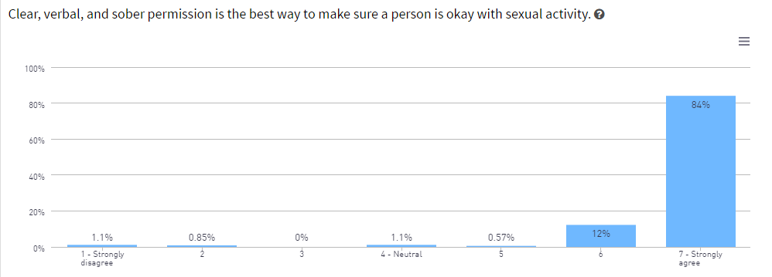
Consent at Rose-Hulman
Notes:
Kristen – the good news is that at Rose-Hulman, 84% of your classmates strongly agree that clear, verbal, and sober permission is the best way to make sure a person is okay with sexual activity. An additional 12% agree. This means that 96% of you are in agreement that this is the best way to seek consent. (4 strongly disagree)

Slide 29
Tea Time?
This may help you better understand consent.
https://www.youtube.com/watch?v=fGoWLWS4-kU
Notes:
Kyle

Slide 30
Relationship Violence?
Relationship violence is a societal epidemic, affecting people of every age, race, class, gender, and sexual orientation.
Young adults age 16-24 are at greatest risk.
Young adults often don’t think relationship violence happens or could happen to them.
Notes:
Kyle

Slide 31
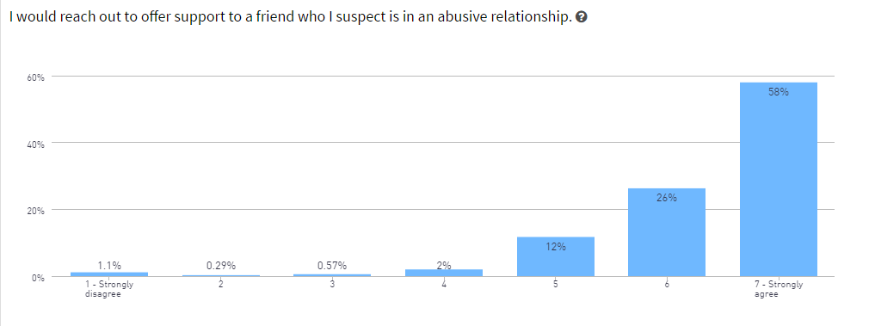
Relationship Violence
Notes:
We have a good family here – 96 percent agree to strongly agree they would reach out to offer support. (once again 4 people are dissenters)

Slide 32
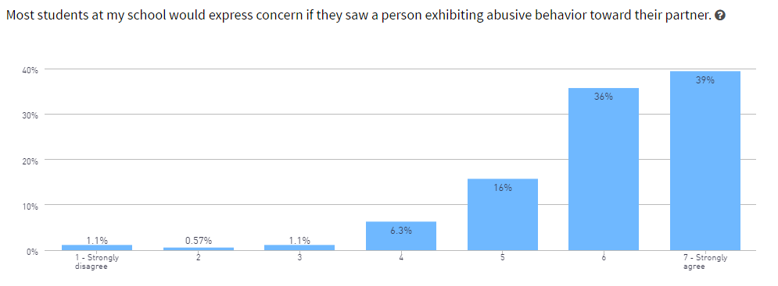
Relationship Violence

Slide 33
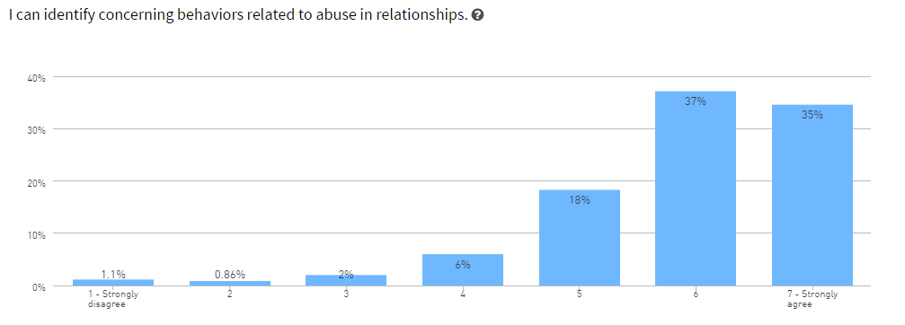
Relationship Violence
Notes:
So let’s quickly talk about what these concerning behaviors are.

Slide 34
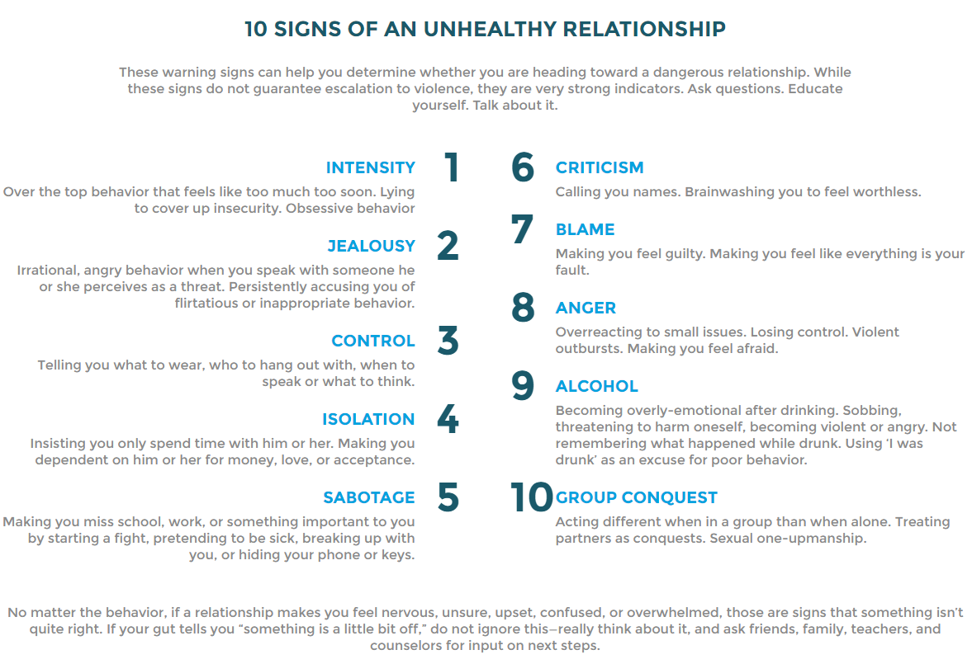
Notes:
So let’s quickly talk about what these concerning behaviors are.
ONELOVE.ORG – more training and workshops to come

Slide 35
Real-Time Resources for Relationship Violence
One Love Foundation – Founded in 2010 to honor the memory of Yeardley Love, One Love works with young people across the country to raise awareness about the warning signs of abuse and activate communities to work to change the statistics around relationship violence
  http://www.joinonelove.org/real_time_resources
Notes:
Kristen – members of our staff will become trained to facilitate workshops regarding relationship violence etc.

Slide 36
So What Does This Mean?
Take care of each other – We R Family – family takes care of family
STEP UP! Be an ACTIVE BYSTANDER!
  Get involved in a situation that might go bad
    That might mean YOU stepping in
    That might mean YOU asking someone else to step in (Public Safety, an RA, a staff member)
Notes:
Kyle

Slide 37
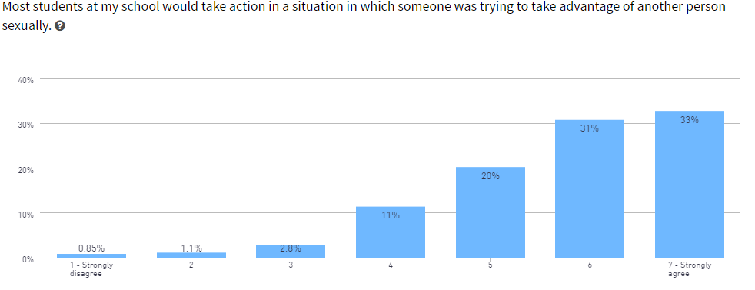
So What Does This Mean?
Notes:
Kyle

Slide 38
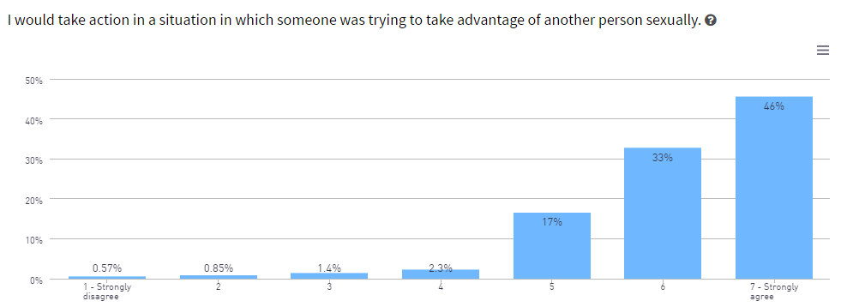
So What Does This Mean?
Notes:
Kristen

Slide 39
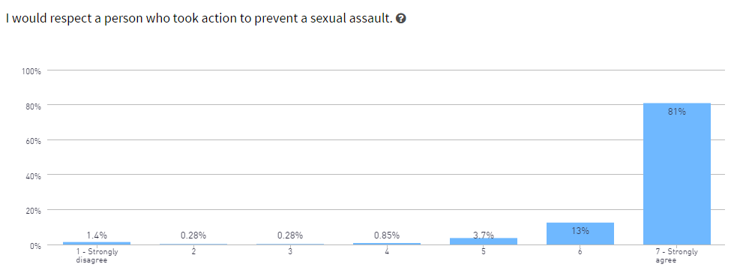
So What Does This Mean?
Notes:
Kristen

Slide 40
What other ways can I be an active bystander?
Academic Misconduct (Cheating on a test, homework, etc.)
Harassing behavior or speech (Inappropriate comments or bullying)
Keeping campus nice! – (littering, walking on grass, throwing rocks in the lake, etc.)
Notes:
Kyle

Slide 41
Conclusion
This was A LOT of information
Take a few minutes to read the policy and procedure – Educate Yourself!
Look out for each other
Make GOOD choices
Step up and do/say something!
Notes:
Kristen

Slide 42
Questions?
Kristen Loyd, Title IX Coordinator
  Director of Student Services
  HMU 244
  loyd1@rose-hulman.edu/812-877-8484
Kyle Rhodes, Assistant Title IX Coordinator
  Associate Director of Residence Life
  HMU 153
  rhodeska@rose-hulman.edu/812-877-8651
  Rose-Hulman’s Policy for Civil Rights Equity can be found here: https://www.rose-hulman.edu/media/1816667/title-ix-rhit-policy-for-civil-rights-equity.pdf

